Slide 1
LSTM and GRU
By Dr. Ali Saeed

Slide 2
Recurrent neural networks
“Humans don’t start their thinking from scratch every second. As you read this essay, you understand each word based on your understanding of previous words. You don’t throw everything away and start thinking from scratch again. Your thoughts have persistence.”
Recurrent neural networks address this issue. They are networks with loops in them, allowing information to persist.

Slide 3
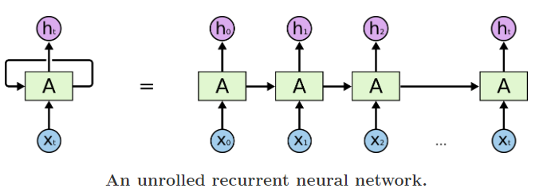
RNN
A recurrent neural network can be thought of as multiple copies of the same network, each passing a message to a successor. Consider what happens if we unroll the loop

Slide 4
Long Short Term Memeory
Long Short Term Memory networks – usually just called “LSTMs” – are a special kind of RNN, capable of learning long-term dependencies.
They were introduced by Hochreiter & Schmidhuber (1997), and were refined and popularized by many people in following work.
They work tremendously well on a large variety of problems, and are now widely used.

Slide 5
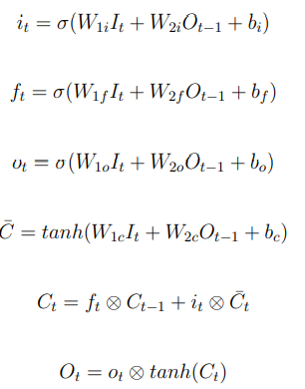
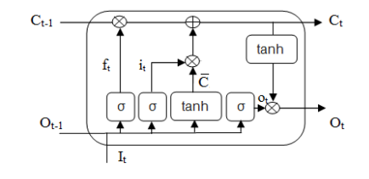

LSTM- Cell
σ represents the sigmoid function Wij indicate the weights, small circle with cross (⊗) illustrates the element wise multiplication, bf , bi and bo are indicating the biases values of forget, input and output gates respectively.

Slide 6
Gated Recurrent Units
Gated Recurrent Units (GRUs) are an enhancement of standard LSTM. GRUs units use fewer gates than LSTM. GRUs units contain two gates, i.e., reset gate (rt) and update gate (ut) (see equation (5.11)).
Applications of GRUs include text classification, text mining and sequence modeling

Slide 7
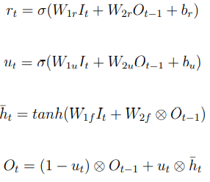
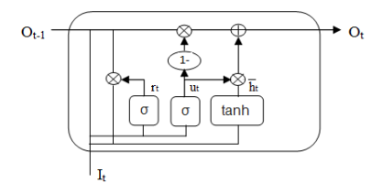
GRU-Cell
Figure 5.3 shows a single unit of a GRUs . In this figure It shows the current input, Ot−1 shows the previous output, Ot shows the current output (Ot computed using equation)

Slide 8
Thanks

